Slide 1

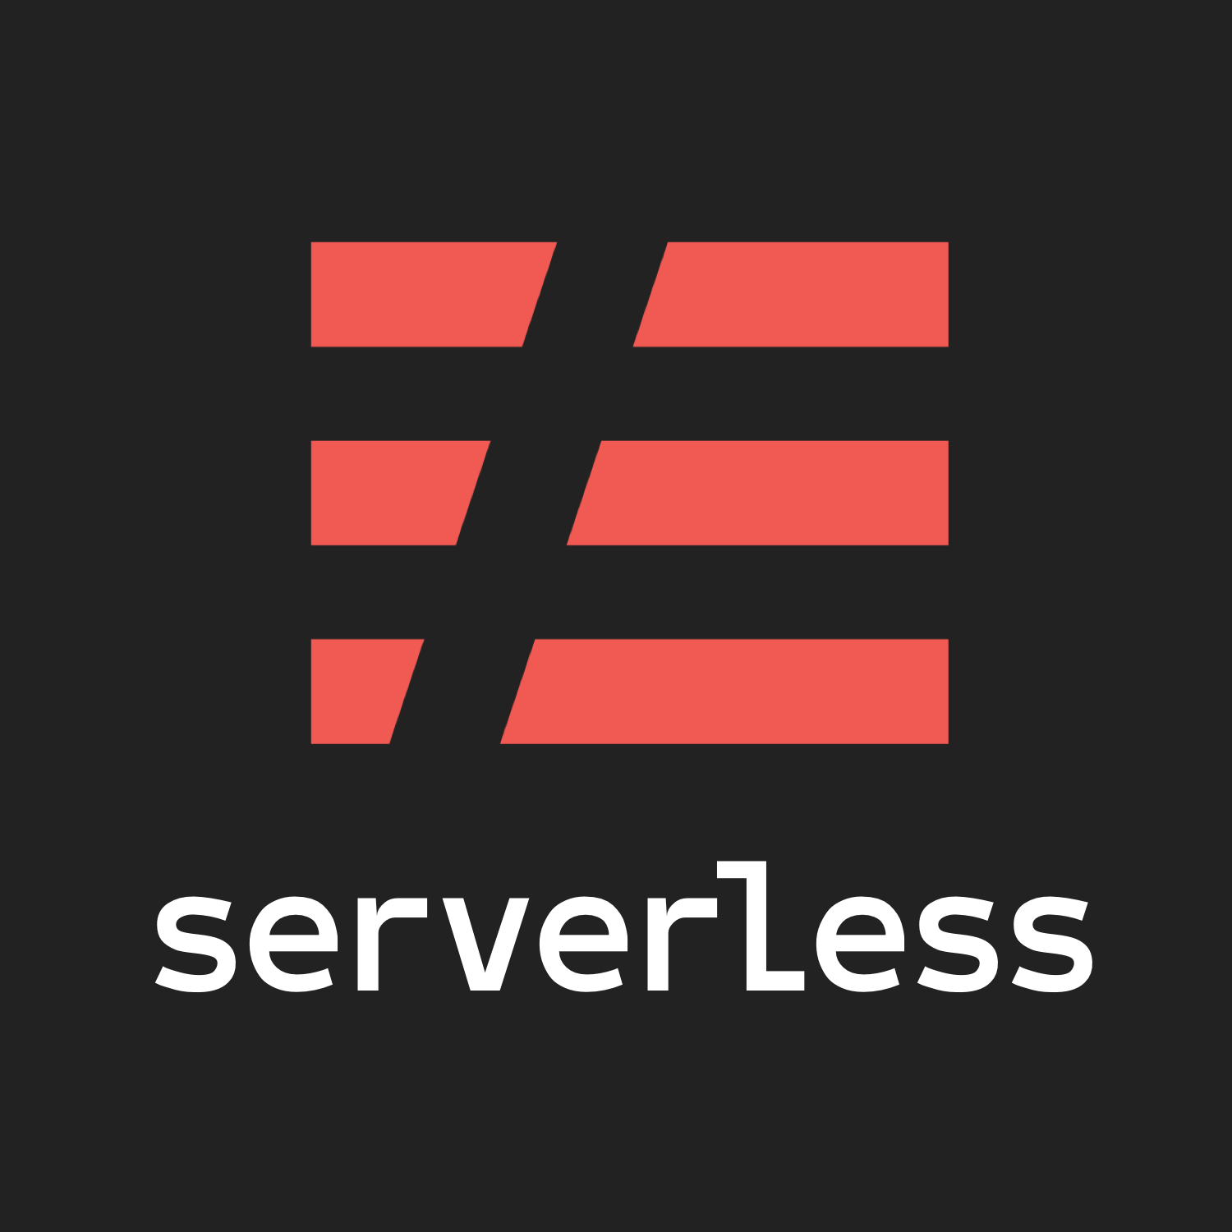
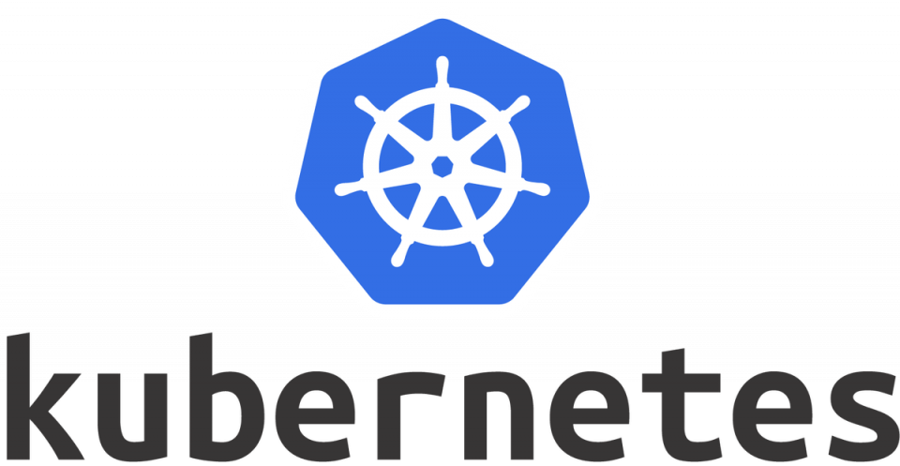
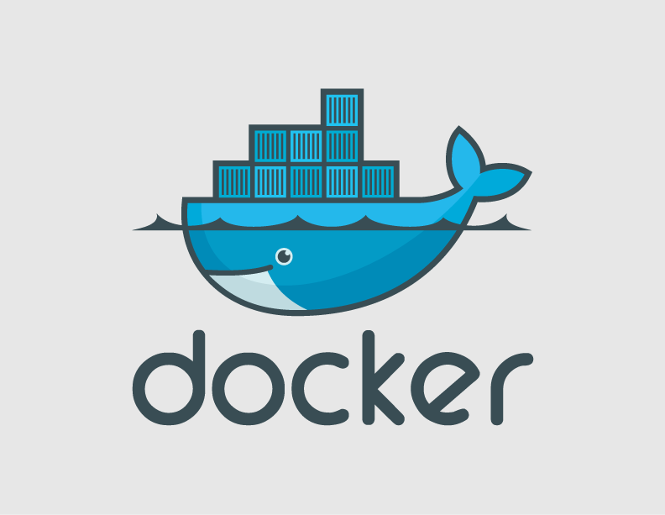
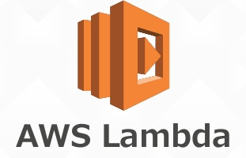
*aaS
#abstractions
Presentation by
#microservices
Jul 2018 | Anastasios Gogos

Slide 2




Containers
HISTORY
IAAS PAAS SAAS BAAS MAAS FAAS CLOUD-NATIVE SERVERLESS
PRESENTATION
STRUCTURE
Kubernetes
Conclusions

Slide 3
HISTORY
IAAS PAAS SAAS BAAS MAAS FAAS CLOUD-NATIVE SERVERLESS
https://loige.co/from-bare-metal-to-serverless/
https://hackernoon.com/why-the-fuss-about-serverless-4370b1596da0

Slide 4
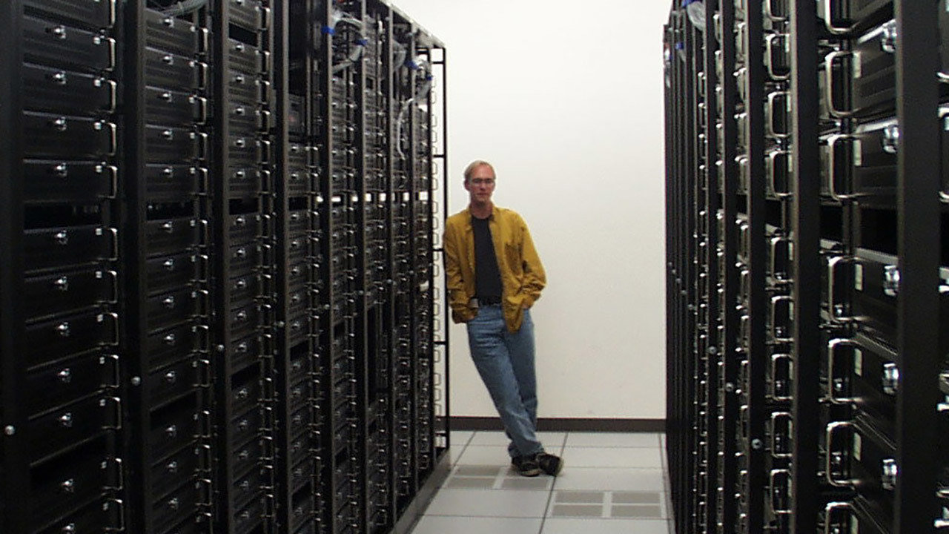
THE
BARE METAL
AGE

Slide 5
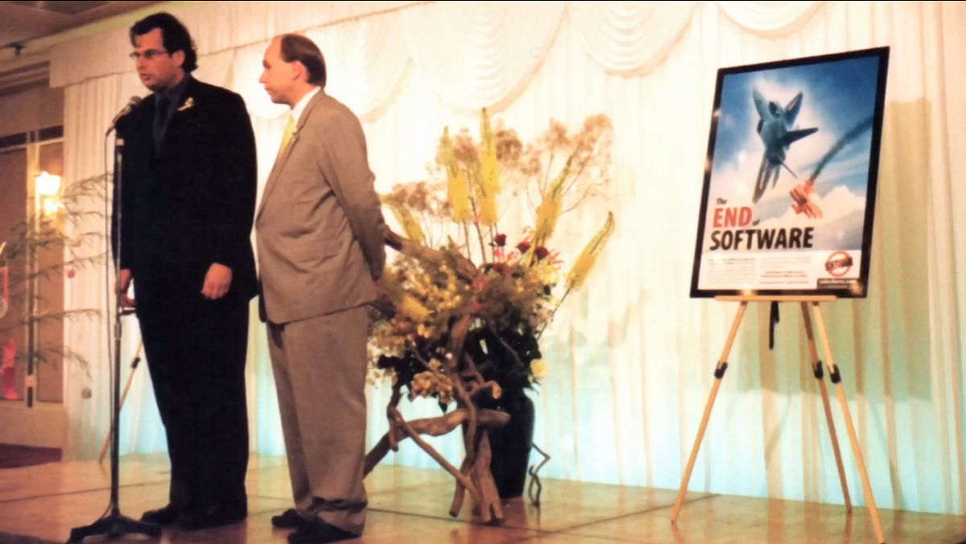
1999
THE
SaaS
AGE
Marc Benioff, 1999
launching Salesforce

Slide 6
MTTR
mean time to recovery
N+1 multiple power-sources capacity planning

Slide 7
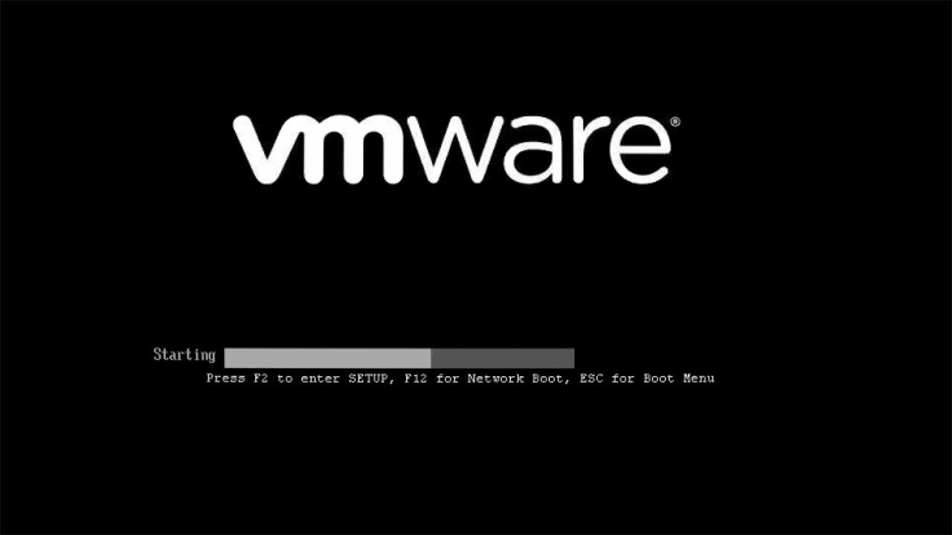
2001
2001, VMWare releases ESXi
and server virtualization becomes a thing

Slide 8
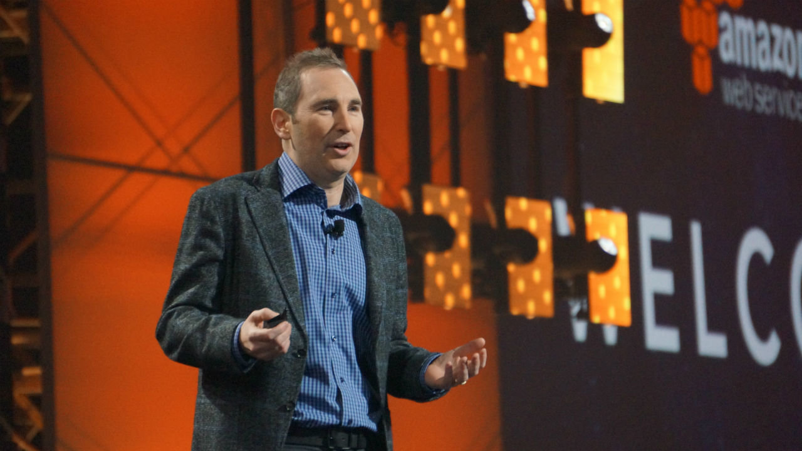
THE
IaaS
AGE
2006
2002-2006 Amazon Web Services
EC2 (Virtual Machine service), S3 (Scalable storage service) and SQS (message queuing system)

Slide 9
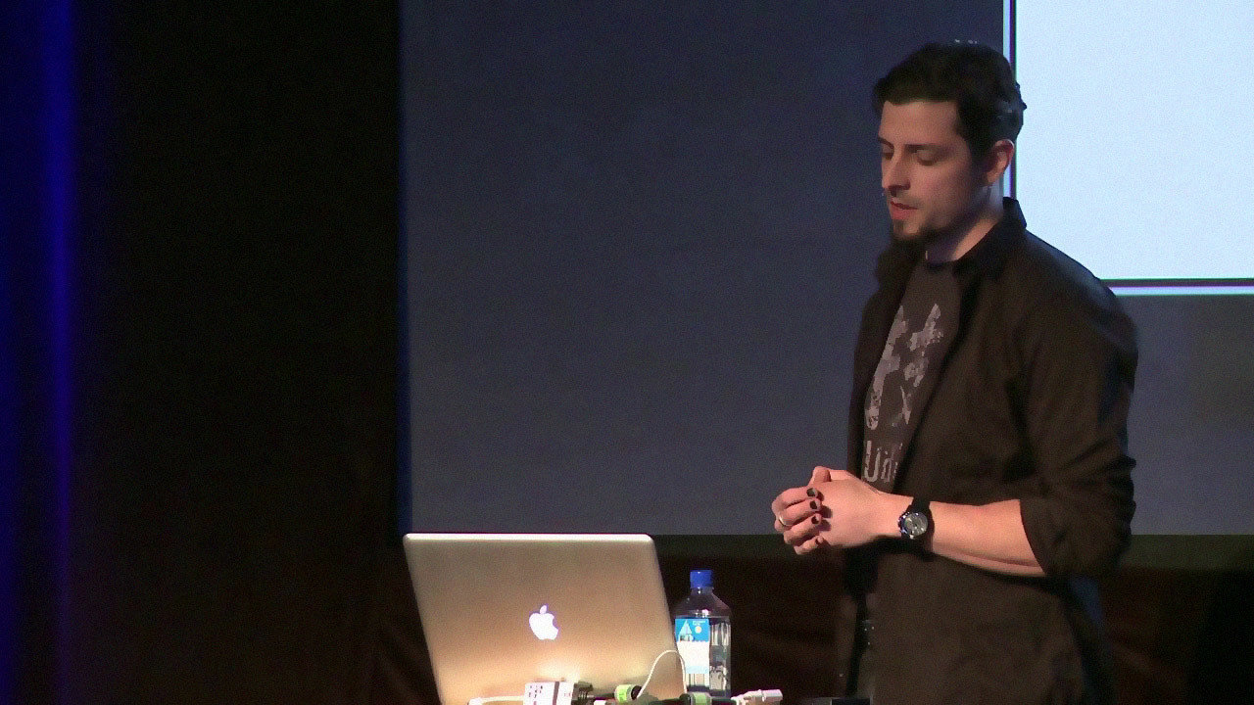
THE
PaaS
AGE
2009
2009, Adam Wiggins
Heroku

Slide 10
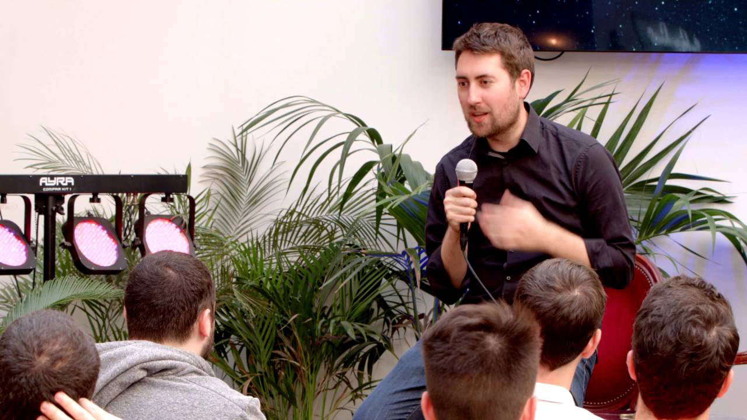
Database-as-a-Service
2011
2011, James Tamplin
Firebase

Slide 11
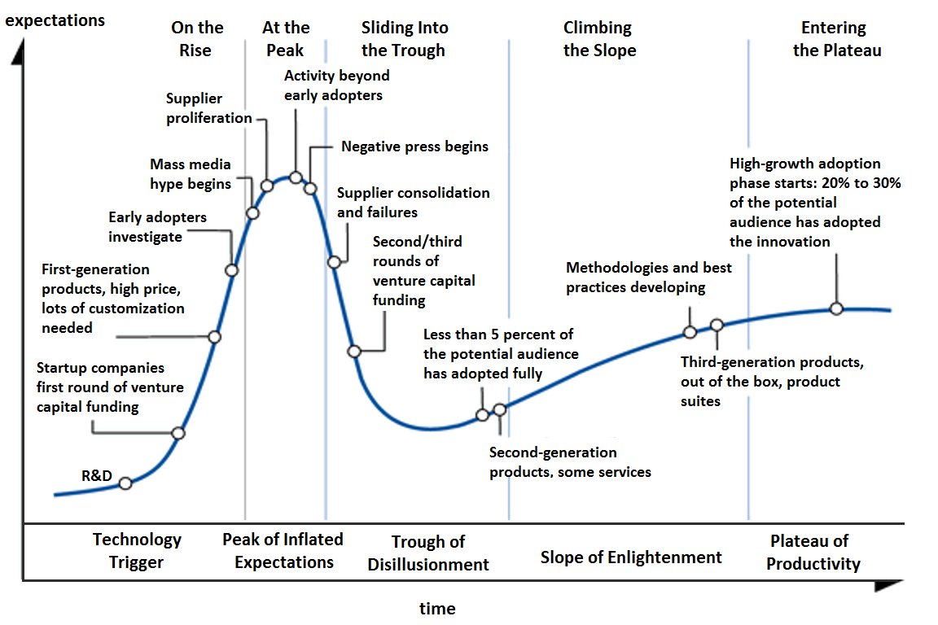
Hype-cycle
2012

Slide 12
Pets or Cattle?
2012

Slide 13
Scale-up or Scale-out?
2012

Slide 14
2012

Slide 15
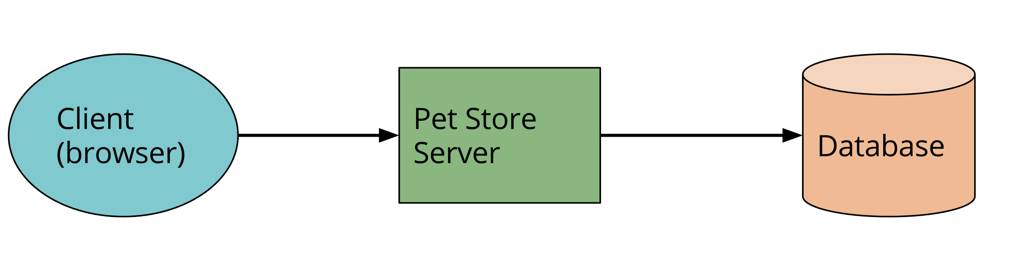
We still haven’t fixed
the deployment times!
apps are monoliths
and this is a problem

Slide 16
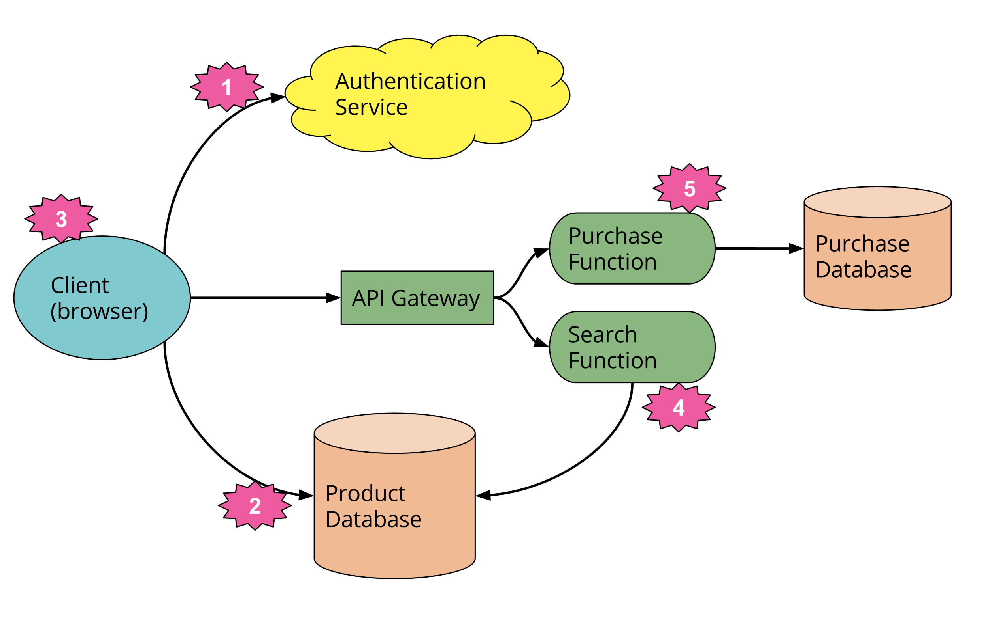
Separation of concerns / Microservices

Slide 17
Containers…
2013
2013, Solomon Hykes
Docker

Slide 18
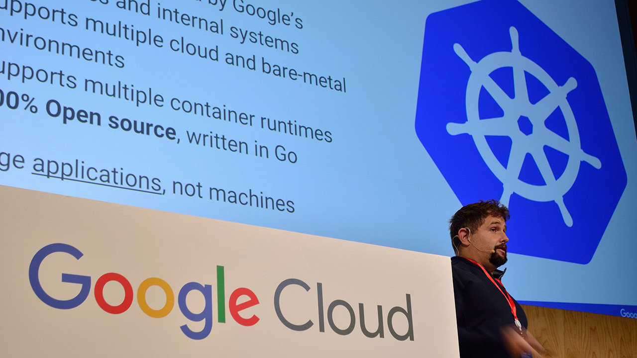
Containers at scale: Kubernetes
2014
2014, Kubernetes

Slide 19
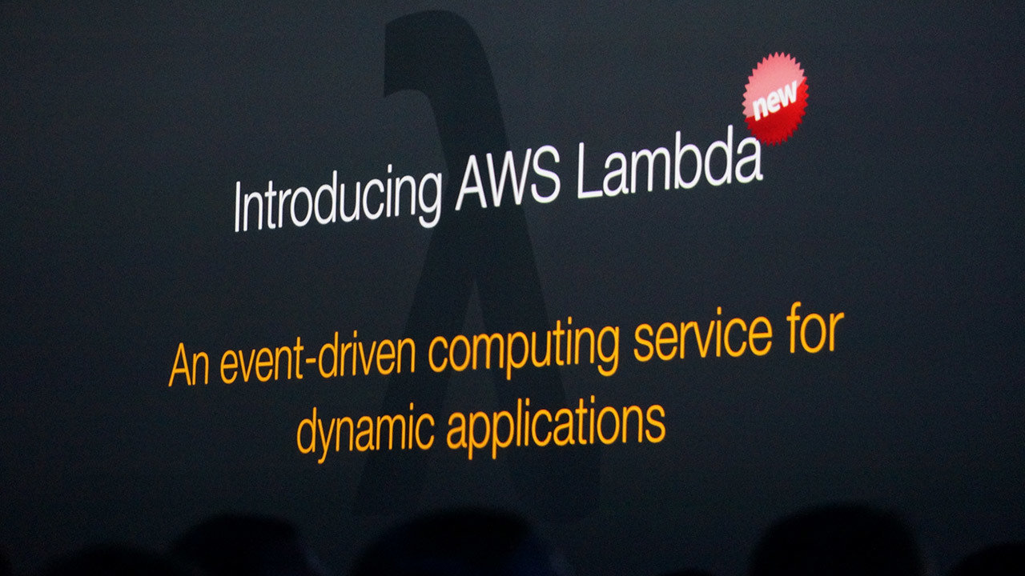
FaaS
2014
2014, AWS Lambda

Slide 20
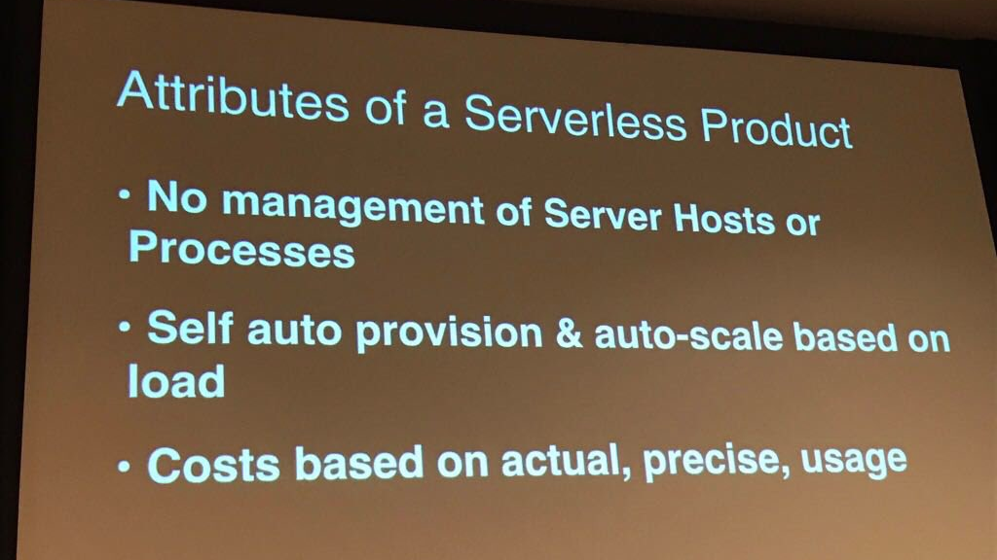
2018

Slide 21
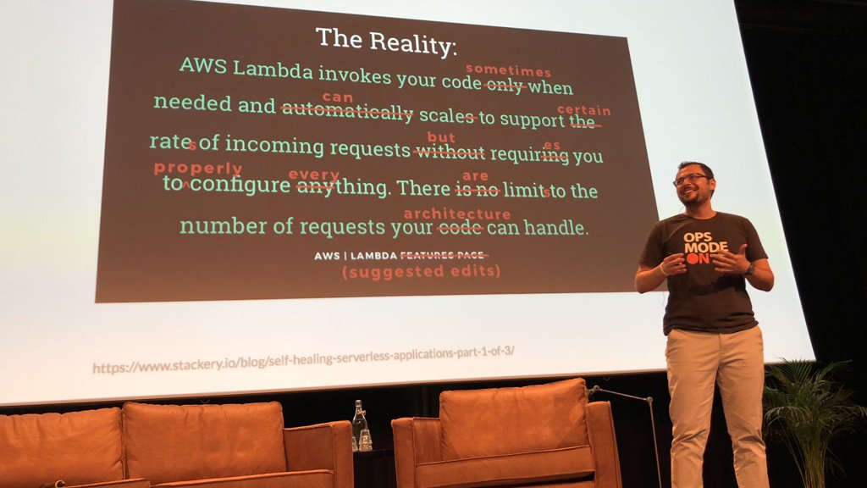
June
2018
#DevOpsDays

Slide 22
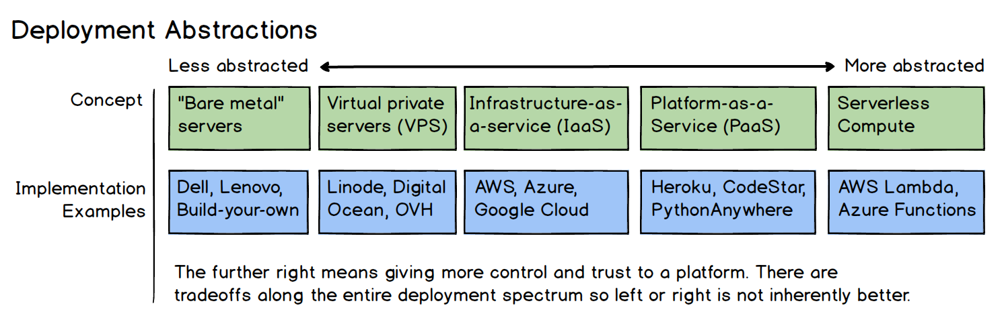
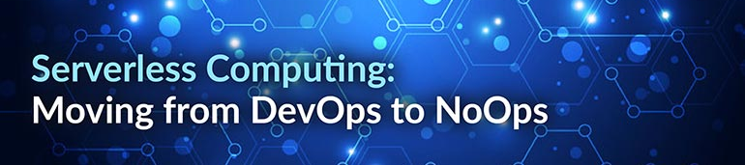
2014, AWS Lambda

Slide 23
Cloud-native?
Serverless?
What is it all about?
*aaS?

Slide 25
It’s a developer-focused
wave of services
follows…
@samnewman

Slide 26


Slide 27
Containers
Treating containers like a black box will eventually leave you in the dark.
@kelseyhightower

Slide 28
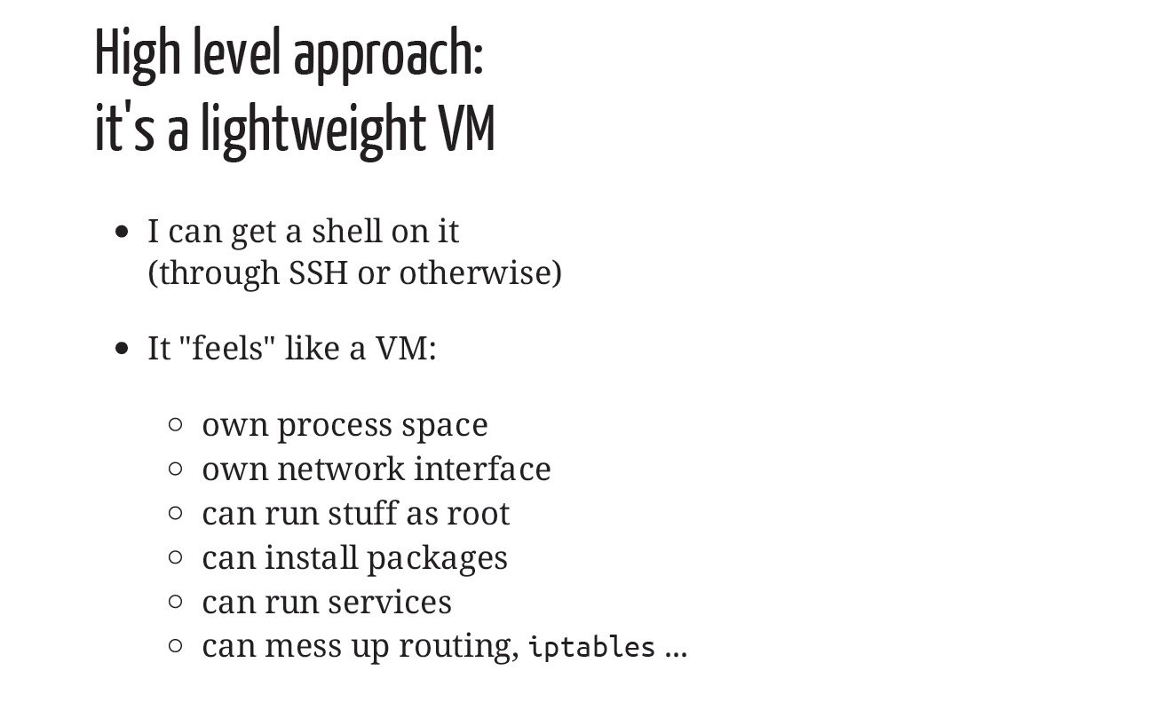
@jpetazzo

Slide 29
@jpetazzo

Slide 31
LXC
…is a system container runtime designed to execute "full system containers", which generally consist of a full operating system image. An LXC process, in most common use cases, will boot a full Linux distribution such as Debian, Fedora, Arch, etc, and a user will interact with it similarly to how they would with a Virtual Machine image.
LXD
…is similar to LXC but is a REST API on top of liblxc which forks a monitor and container process. This ensures the LXD daemon is not a central point of failure and containers continue running in case of LXD daemon failure. All other details are nearly identical to LXC.

Slide 32
Container Wars
“Docker’s architecture is fundamentally flawed”
At the heart of Docker is a daemon process that is the starting point of everything Docker does. The docker executable is merely a REST client that requests the Docker daemon to do its work. Critics of Docker say this is not very Linux-like.

Slide 33
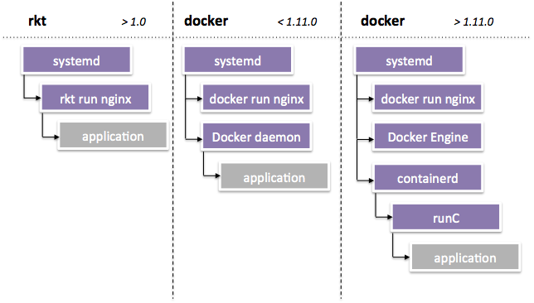
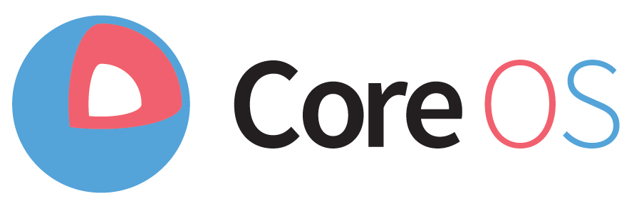

Container Wars
runC is a low-level container runtime and an implementation of the OCI spec. runC exposes and expects a user to understand low-level details of the host operating system and configuration
containerd is a daemon to control runC.

Slide 34
Kubernetes

Slide 37
Remember Container runtimes?

Slide 38
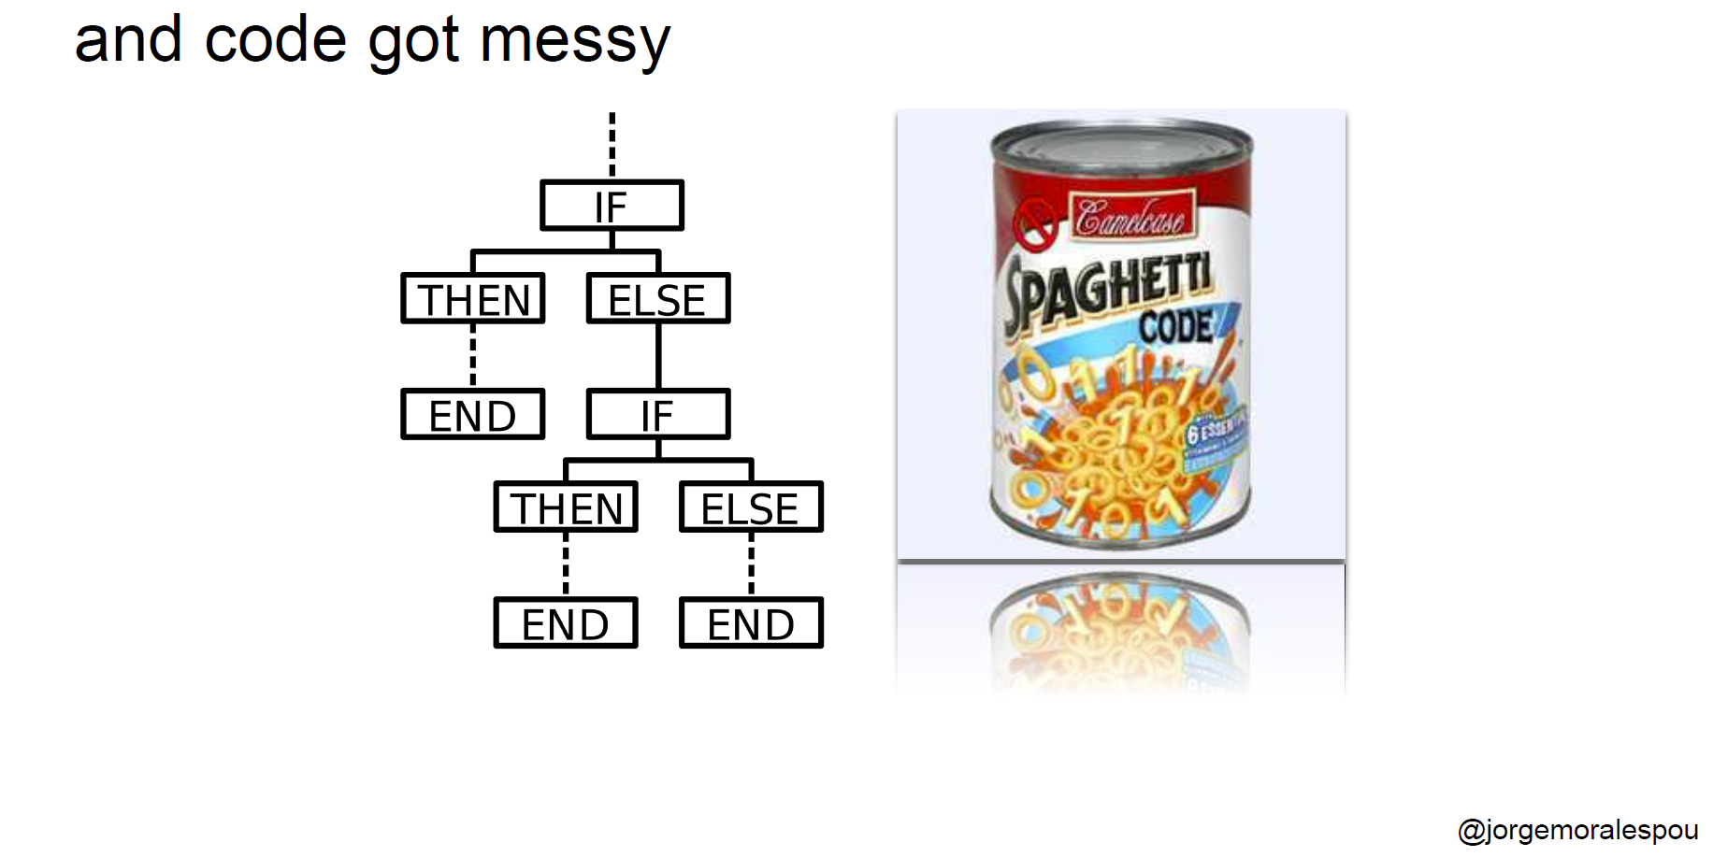

Slide 44
Why Use Container Orchestrators?
Though we can argue that containers at scale can be maintained manually, or with the help of some scripts, container orchestrators can make things easy for operators.

Slide 45
Container orchestrators can:
Bring multiple hosts together and make them part of a cluster
Schedule containers to run on different hosts
Help containers running on one host reach out to containers running on other hosts in the cluster
Bind containers and storage
Bind containers of similar type to a higher-level construct, like services, so we don't have to deal with individual containers
Keep resource usage in-check, and optimize it when necessary
Allow secure access to applications running inside containers.
With all these built-in benefits, it makes sense to use container orchestrators to manage containers.

Slide 46
Basic things we can ask Kubernetes to do
Start 5 containers using image atseashop/api:v1.3
Place an internal load balancer in front of these containers
Start 10 containers using image atseashop/webfront:v1.3
Place a public load balancer in front of these containers
It's Black Friday (or Christmas), traffic spikes, grow our cluster and add containers
New release! Replace my containers with the new image atseashop/webfront:v1.4
Keep processing requests during the upgrade; update my containers one at a time
@jpetazzo

Slide 47
Other things that Kubernetes can do for us
Basic autoscaling
Blue/green deployment, canary deployment
Long running services, but also batch (one-off) jobs
Overcommit our cluster and evict low-priority jobs
Run services with stateful data (databases etc.)
Fine-grained access control defining what can be done by whom on which resources
Integrating third party services (service catalog)
Automating complex tasks (operators)
@jpetazzo

Slide 48
Declarative vs imperative
Our container orchestrator puts a very strong emphasis on being declarative
Declarative:
  I would like a cup of tea.
Imperative:
  Boil some water. Pour it in a teapot. Add tea leaves. Steep for a while. Serve in cup.
Declarative seems simpler at first ...
... As long as you know how to brew tea
@jpetazzo

Slide 49
Declarative vs imperative in Kubernetes
Virtually everything we create in Kubernetes is created from a spec
Watch for the spec fields in the YAML files later!
The spec describes how we want the thing to be
Kubernetes will reconcile the current state with the spec (technically, this is done by a number of controllers)
When we want to change some resource, we update the spec (desired state)
Kubernetes will then converge that resource
@jpetazzo

Slide 50
Kubernetes network model
TL,DR:
    Our cluster (nodes and pods) is one big flat IP network.
In detail:
    all nodes must be able to reach each other, without NAT
    all pods must be able to reach each other, without NAT
    pods and nodes must be able to reach each other, without NAT
    each pod is aware of its IP address (no NAT)
    Kubernetes doesn't mandate any particular implementation
@jpetazzo

Slide 51
Kubernetes network model: the good
Everything can reach everything
No address translation
No port translation
No new protocol
Pods cannot move from a node to another and keep their IP address
IP addresses don't have to be "portable" from a node to another (We can use e.g. a subnet per node and use a simple routed topology)
The specification is simple enough to allow many various implementations
@jpetazzo

Slide 52
Kubernetes network model: the less good
Everything can reach everything
    if you want security, you need to add network policies
    the network implementation that you use needs to support them
There are literally dozens of implementations out there (15 are listed in the Kubernetes documentation)
It looks like you have a level 3 network, but it's only level 4 (The spec requires UDP and TCP, but not port ranges or arbitrary IP packets)
kube-proxy is on the data path when connecting to a pod or container, and it's not particularly fast (relies on userland proxying or iptables)
@jpetazzo

Slide 53
Kubernetes network model: kube-proxy
Don't worry about the warning about kube-proxy performance
Unless you:
    routinely saturate 10G network interfaces
    count packet rates in millions per second
    run high-traffic VOIP or gaming platforms
    do weird things that involve millions of simultaneous connections (in which case you're already familiar with kernel tuning)
@jpetazzo

Slide 54
Conclusions

Slide 55
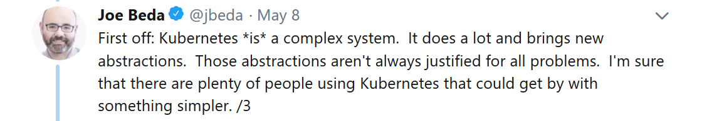
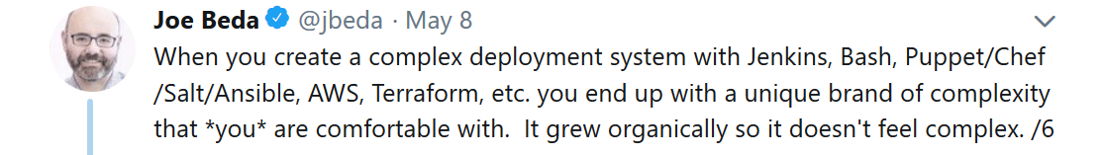
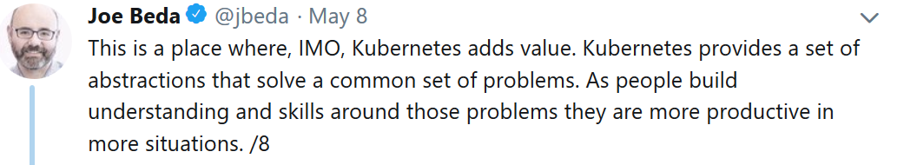
Thoughts from one of the creators of Kubernetes

Slide 56
Abstractions are NOT
a new thing,
It’s how CS evolved
BUT…

Slide 57

Architecture Astronauts
“
When you go too far up, abstraction-wise, you run out of oxygen. Sometimes smart thinkers just don’t know when to stop, and they create these absurd, all-encompassing, high-level pictures of the universe that are all good and fine, but don’t actually mean anything at all.
”
2001, Joel Spolsky
Co-founder @stackoverflow @trello

Slide 58
RFC 1925
“
1 April 1996
(6) It is easier to move a problem around (for example, by moving the problem to a different part of the overall network architecture) than it is to solve it.
  (6a) (corollary). It is always possible to add another level of indirection.
”

Slide 59
FTSE
Fundamental Theorem of Software Engineering
“
We can solve any problem by introducing an extra level of indirection.
”
The theorem is often expanded by the humorous clause
“…except for the problem of too many levels of indirection”

Slide 60
too many
Abstractions =
may create intrinsic
Complexity
issues of their own

Slide 61
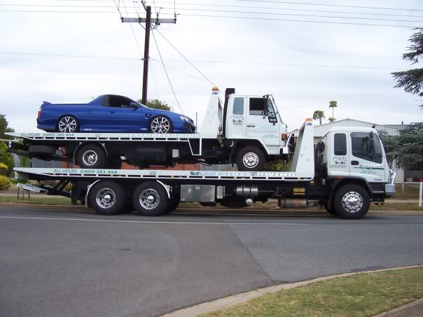
Kubernetes on
Openstack

Slide 62
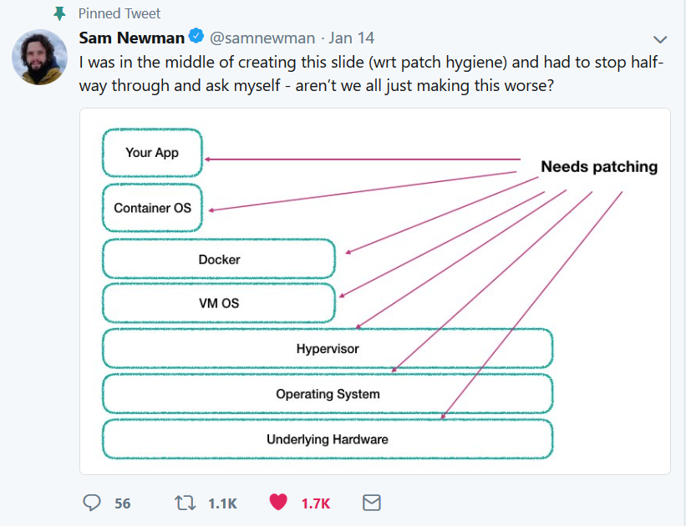

Slide 63
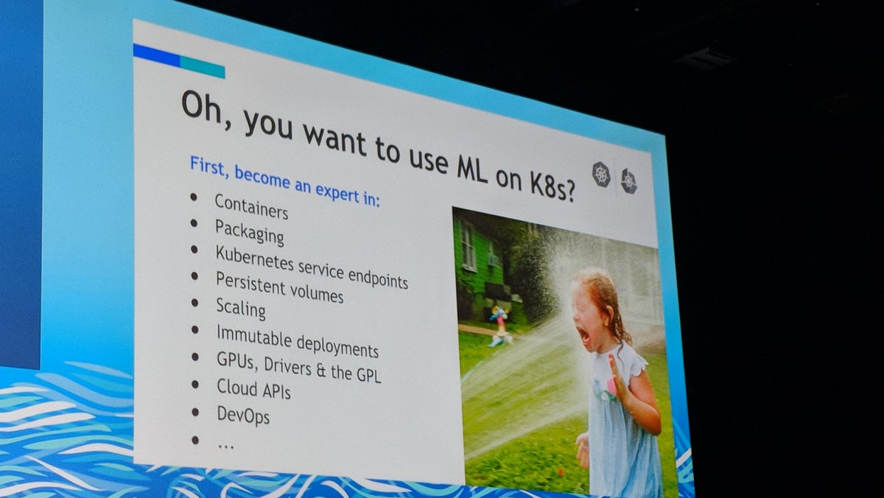

Slide 64


Slide 65

That’s all…

Slide 66
Links
https://loige.co/from-bare-metal-to-serverless/
https://hackernoon.com/why-the-fuss-about-serverless-4370b1596da0
https://www.martinfowler.com/articles/serverless.html
https://www.slideshare.net/randybias/the-history-of-pets-vs-cattle-and-using-it-properly
https://www.slideshare.net/spnewman/what-is-this-cloud-native-thing-anyway
https://www.slideshare.net/spnewman/confusion-in-the-land-of-the-serverless
https://www.slideshare.net/JorgeMorales124/build-and-run-applications-in-a-dockerless-kubernetes-world
https://medium.com/@adriaandejonge/moving-from-docker-to-rkt-310dc9aec938
https://coreos.com/rkt/docs/latest/rkt-vs-other-projects.html
https://www.slideshare.net/jpetazzo/anatomy-of-a-container-namespaces-cgroups-some-filesystem-magic-linuxcon

